Slide 1
Test Driving Your Infrastructure

Slide 2
Things We Will Cover
Standing up an environment using terraform
Verifying it’s configuration using RSpec
Verifying behaviors of our puppet modules using Test Kitchen and Serverspec
Verifying our applied configurations using Serverspec against the live environment

Slide 3
Levels of Testing
Infrastructure / Environment configurations such as proper setup of auto scaling groups, launch configurations, and instances.
Puppet module behaviors
Actual implementation of configurations in environments

Slide 4
Environment Setup & Testing
Terraform
RSpec
AWS SDK for Ruby

Slide 5
Puppet Modules
Test Kitchen using Docker or Vagrant
Verify behaviors of Puppet modules as we develop them using Serverspec

Slide 6
Applied Configuration
Serverspec to verify the specific configurations we expect to be applied for each environment.

Slide 7
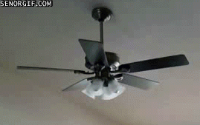
Let’s Talk About Continuous Integration
Notes:
Integrate everyone’s code frequently and make sure it plays nicely together

Slide 8

Continuous Integration
Jenkins jobs are managed as code using the DSL Plugin. Updates to jobs are done by opening a pull request, and Jenkins server is “just another puppet module”
Notes:
We use the docker image published by jenkins as our base image
Volume mount the jenkins home which contains all of the plugins and config
Use the DSL pluing to reseed jobs as new code is committed to that repository

Slide 9

Continuous Integration
When new environment configuration (Terraform) is applied we run integration tests to ensure systems are configured properly, and all expected services are running.

Slide 10

Continuous Integration
When code is committed to a puppet module we run Test Kitchen tests using an EC2 driver to quickly discover things that only “work on my machine”
Notes:
This is how

Slide 11

Continuous Integration
Teams who work closely with key applications and components have been developing acceptance tests focused on verifying key application components are operating as expected.

Slide 12

Continuous Integration
Applications are built and deployed to artifactory using Jenkins. Puppet configuration can then be updated to deploy newly built applications. Integration and acceptance tests will verify things are operating as expected after any configuration updates have been applied.

Slide 13
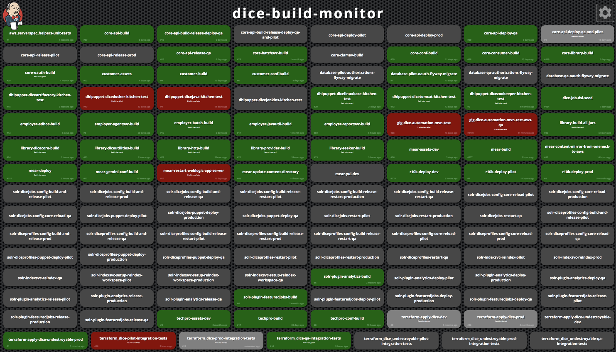
Continuous Integration
All of this is reflected on our build monitor which is visible to anyone in our team space

Slide 14
That sounds like a lot…let’s talk benefits

Slide 15

Discover Problems Quickly
This is a new to us...we experience many failures.
Notes:
But when we do the scope is narrow since the last change
Teams are working together and there isn’t finger pointing

Slide 16

Automation is Reproducible
Since everything is automated we’re able to reproduce those failures and resolve them more easily.
Notes:
Ideally right? Still a work in progress :)

Slide 17
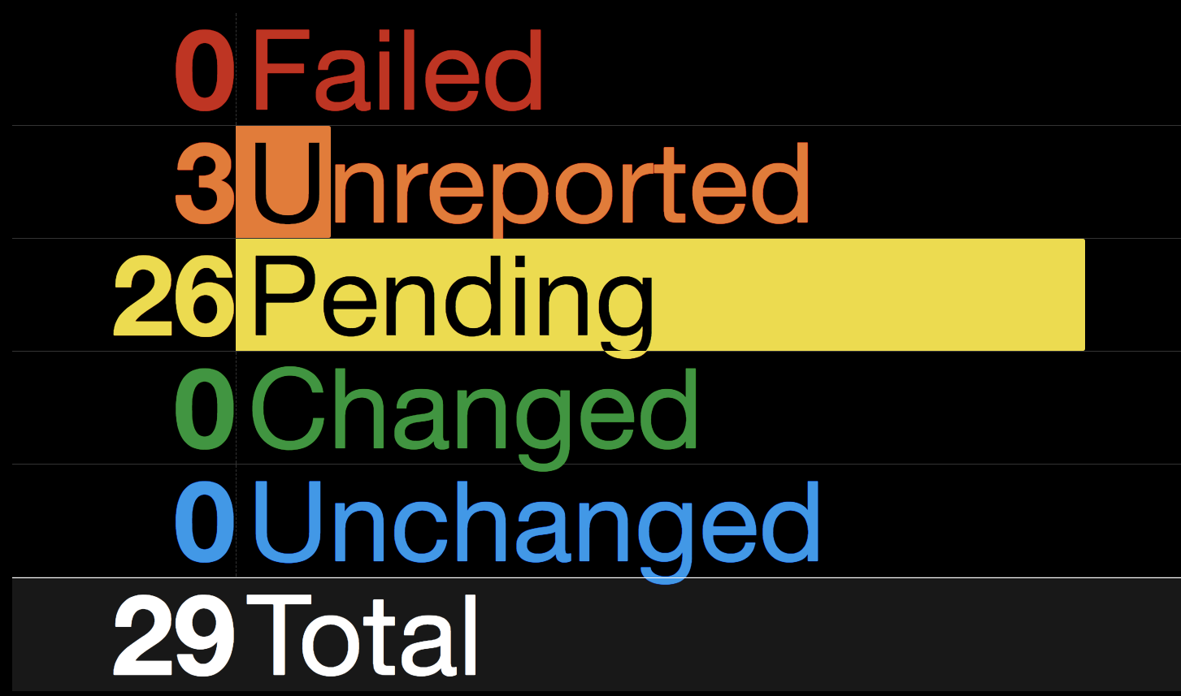
Visibility + Reproducibility = Stakeholder Confidence

Slide 18

Questions?
Examples and slides: https://github.com/jessiepuls/2017-08-aws-meetup
Feel free to contact me: @jessiepuls

